Slide 1

Advanced Prototype
WELCOME
TO OUR PRESENTATION
Code Pros
MoneyCTRL app

Slide 2
Contents
Code Pros
Changes
Design Solution
Storyboard
Coding Conventions
Rationale of design
Context of Use
Design Pattern

Slide 3
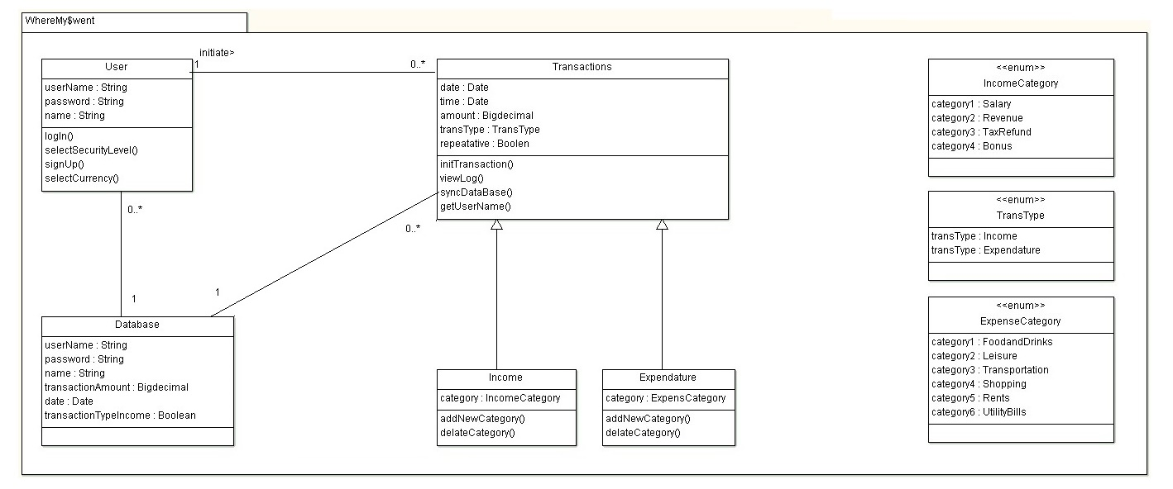
Class Diagram
Code Pros
Captures only basic requirements

Slide 4
Reason?
Code Pros
Additional Libraries and Classes
MP Charts
Reason?
GUI
Application
Adapter
Date Picker
Room Database
User Friendly
Application

Slide 5
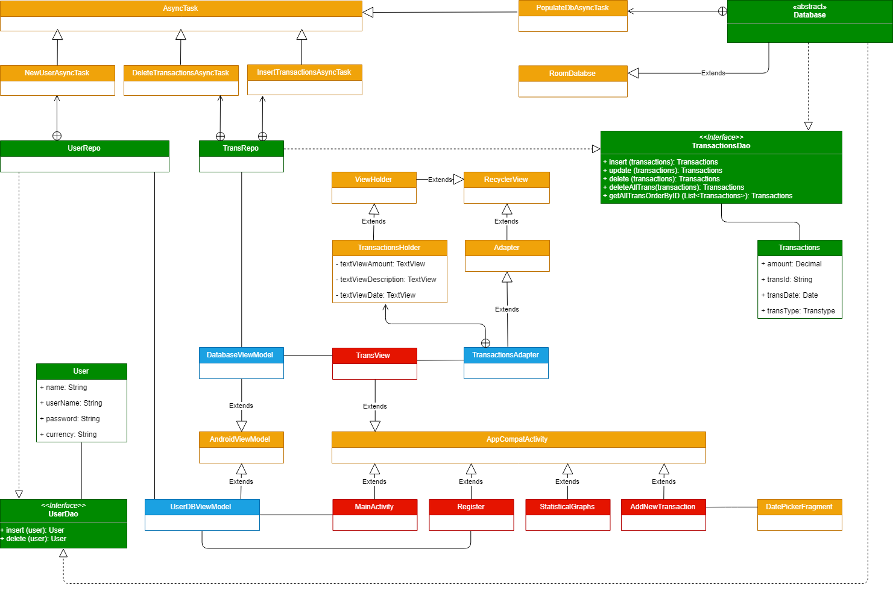
Class Diagram
Code Pros
Captures almost all parts of this project

Slide 6
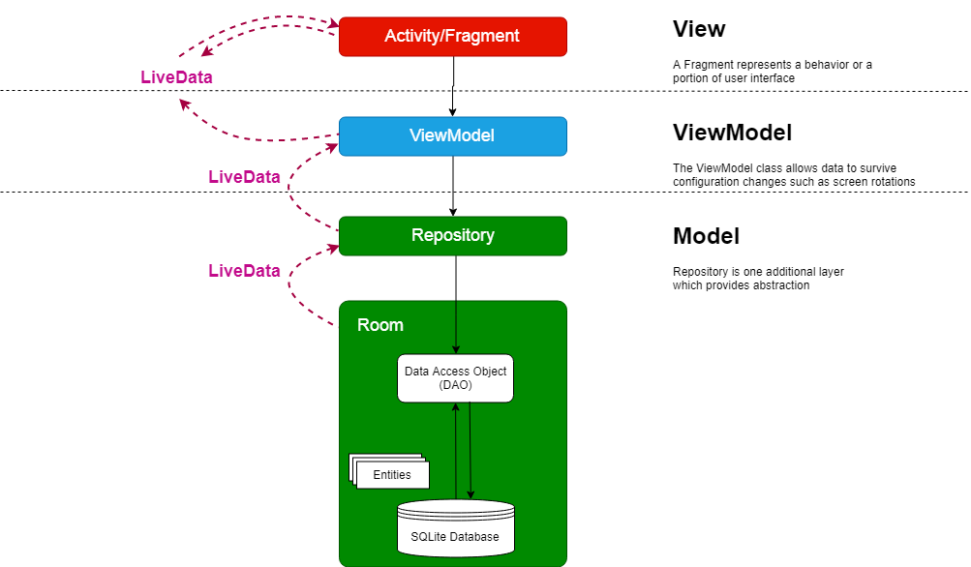
Design Patterns
Code Pros

Slide 7
Design Patterns
Code Pros
MVVM Architecture
MVVM
Model
View
ViewModel
100% test coverage
Data binding had a positive impact on the testability of the application
reusability of components
Separation of fragments from business logic
Data binding makes the separations of business logic from fragment/activity much easier
Scalability
designer-developer interaction
designers can work independently without interfering with developer’s work

Slide 8
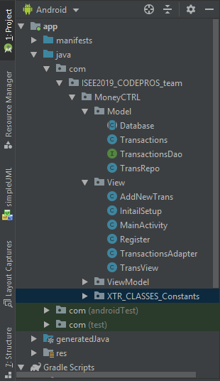
Structure of packages in our project
Code Pros
Reflects the design patterns in packages
Model View ViewModel

Slide 9
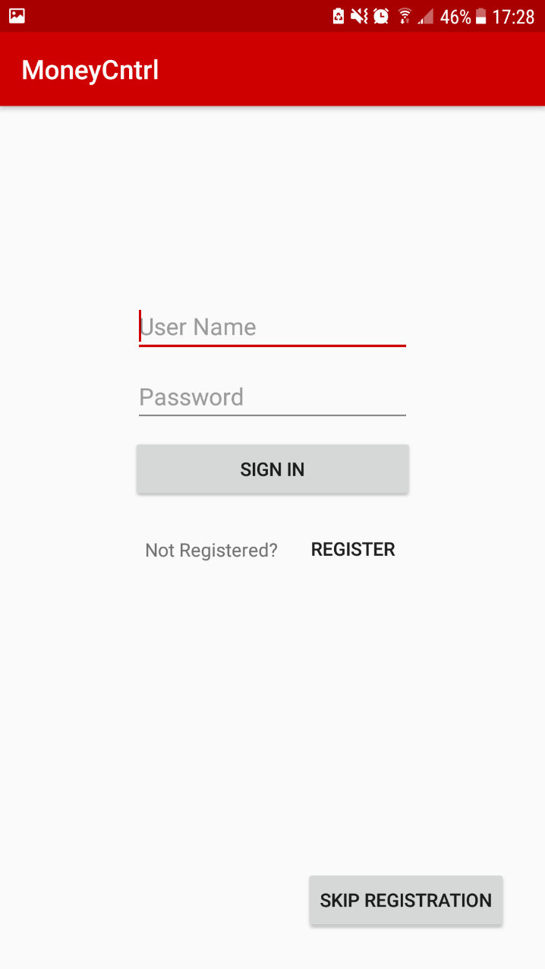
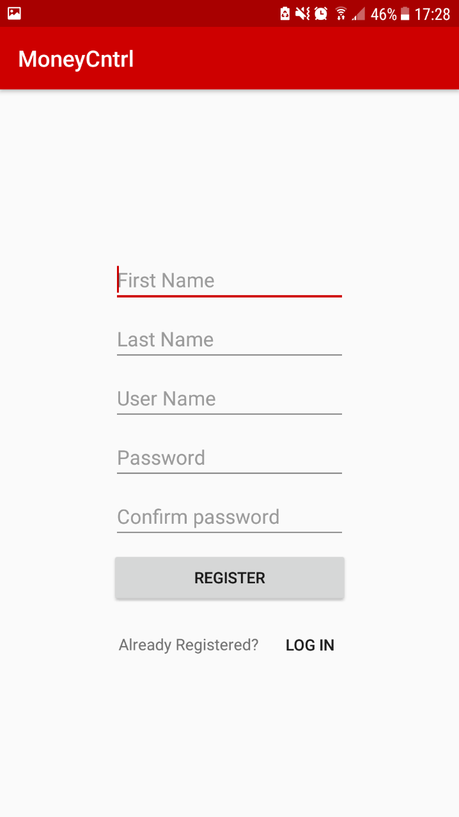
Login and Register pages
Code Pros
Can skip
registration

Slide 10
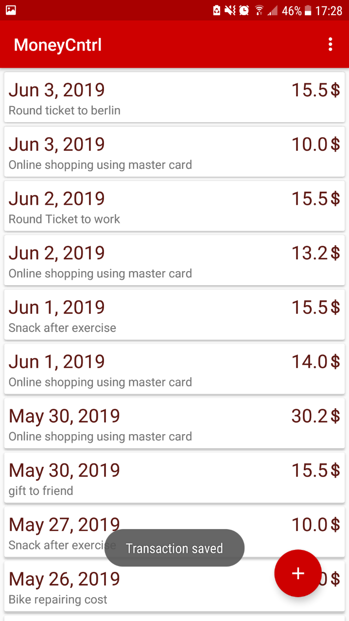
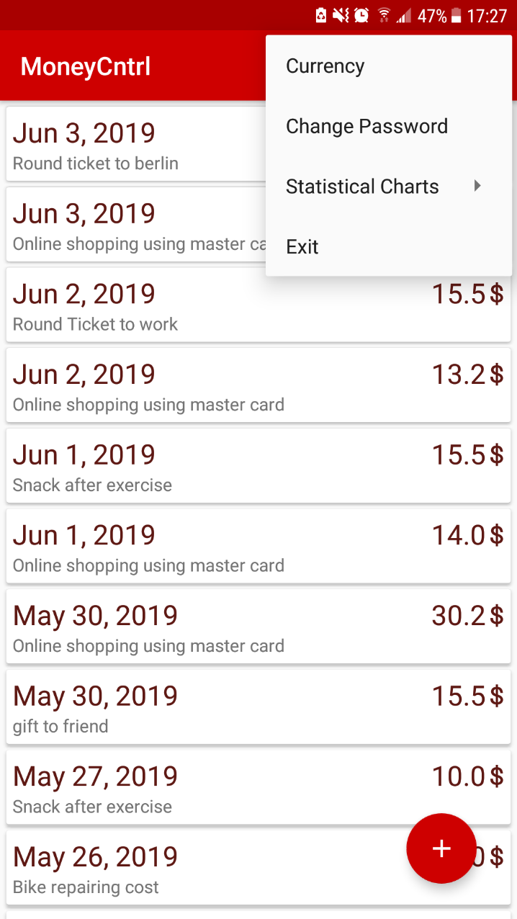
Transactions view list
Code Pros
Can change password
and navigate to statistical charts

Slide 11
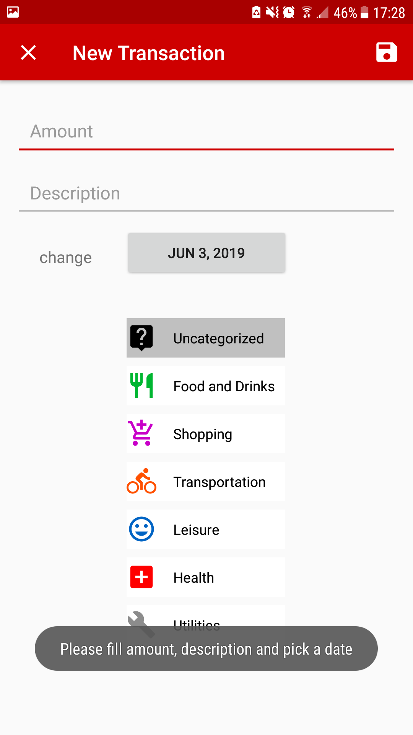
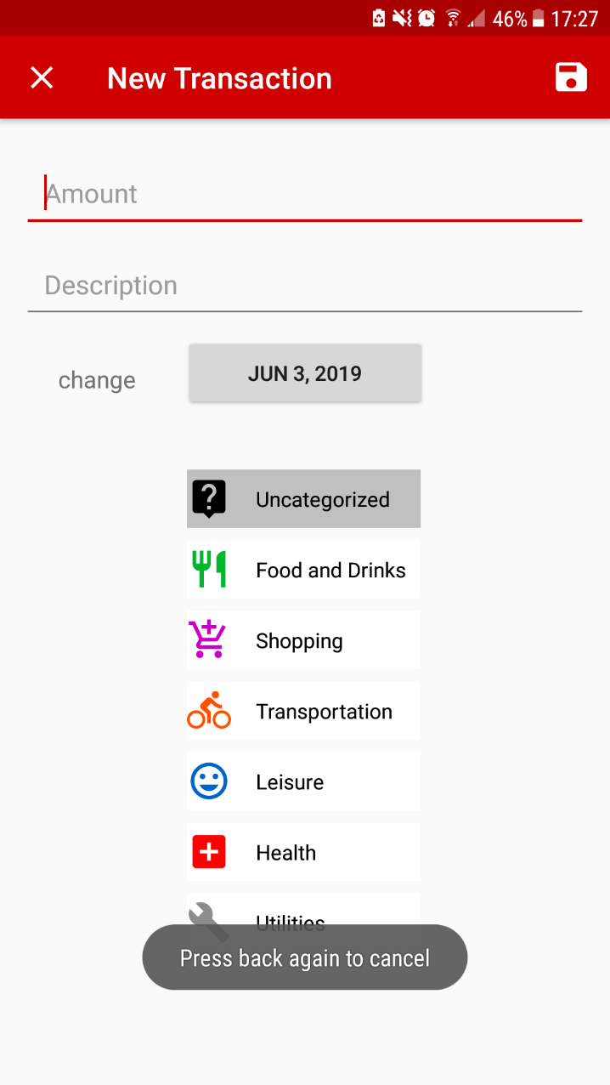
Add new transaction
Code Pros
Fully controlled with messages
Required fields need to be filled
to be save

Slide 12
Storyboard
Code Pros
Case 1>:
User : IT Employee
Assumption: Already registered
Sequence of screens he encounters :
• As soon as he opens the app , he will be greeted by the login page where he will enter his credentials and clicks on Login
• Next he will be taken to the transactions page ,where he will be able to view previous transactions for the month and also the balance
• He can add a new transaction by clicking the small + sign at the bottom right of the screen
1. He can enter the amount and Description and click save and it gets reflected on the transactions page
• In the Transactions page , he can click on the settings icon from where he can logout of the system.

Slide 13
Storyboard
Code Pros
Case2>:
User: Student
Assumption :New user
Sequence of screens he encounters :
He opens the app and sees that he needs to register to be able to use the app
So ,he clicks on the register here button where he will be asked to provide his username , password and also confirm his password .
He clicks on the done button after entering his details which then again takes him back to the login page

Slide 14
Coding Conventions
Code Pros
As Java is used as the programming language, we use the general Java coding conventions like :
Using mixcase names for Classes and Interfaces
Liberal usage of comments for code blocks and single line comments so that its easy to understand and maintain
Methods use verbs: setId, getDescription etc..
Usage of Indentation to convey programming structure.

Slide 15
